Slide 1
Potential of ELV in Malaysia
Bok Wee, Gwee
President, MAARA
6th September 2013

Slide 2
Background of ELV in Malaysia
In 2009, the Malaysian government announced the National Automotive Policy as below:
Gradual Phase-out of imported used parts and components
Safety and environmental concerns rose from the practice of importing used parts and components without any restrictions or mandatory tests. The NAP Review is introducing a mechanism to prohibit imports of used parts and components, effective from June 2011

Slide 3
Action by MAARA
Hire a professional team from local university to develop report known as
A Comprehensive Study for Presentation as a Response on the National Automotive Policy to the Government
Study concluded that:
.
It will not improve safety and promote environmental-friendly opportunities but it will erode safety, increase environmental degradation and worsen the welfare of the industry, and consumers

Slide 4
Results of Actions
The government announced to ban 4 items of used automotive parts
Brake pads
Brake Linings
Tyres
Batteries

Slide 5
Transformation plan
MAARA planned to transform the industry to a governed industry to restore government and consumers’ confidences:
MAARA launch a serial of transformation plan with the slogan:
Transformations Pave Way for Better Opportunity
勇于转型， 发掘商机

Slide 6
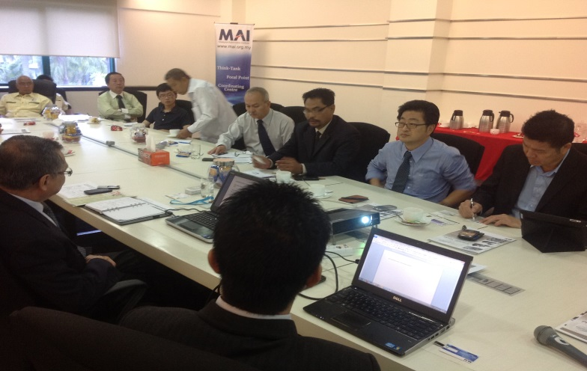
Transformation plan
Launching of My Auto Recycling to improve communication between recyclers and government agency.
Working with MAI to develop National Occupation Skill Standard for the future accreditation program to enhance the skill of recyclers .
Working with SIRIM to develop Malaysian standard for ELV.
Developing Standard Operating Procedure for MAARA members to benchmark international ATF standard.

Slide 7
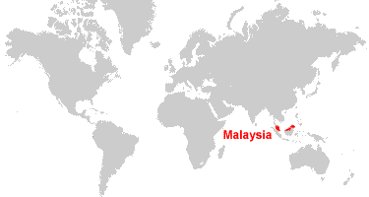
Why Malaysian Auto Recycling Industry?
Advantage Geography
Strategically located at center of Asia Pacific makes Malaysia a strategic international trade marketplace
60% of Malaysian recycled parts export to middle east and African country.
Developed Infrastructure with world class Port e.g. Port Klang, Tanjung Pelepas Port, Penang Port etc

Slide 8
Why Malaysian Auto Recycling Industry?
Increased ownership of vehicle
From 2005- June 2013, Malaysia has the total no of 4,600,597 units of car registration not including the figure prior to 2005.
Year | No of Units
2005 | 537900
2006 | 458294
2007 | 468512
2008 | 537092
2009 | 513954
2010 | 585304
2011 | 594610
2012 | 628239
Source: Malaysia Automotive association

Slide 9
Why Malaysian Auto Recycling Industry?
In Malaysia history, we only officially scrap 58,941 cars in year 2009-2011 under the X-change program initiated by the government and 2 national car maker i.e. Proton & Perodua.
No of Vehicle collected & scrapped
 | 2009 | 2010 | 2011
Scraped | 11,507 | 45,368 | 2,096
Car Collected | 26,716 | 21,310 | 336
ELV waste recovery amount
Metric Tonnes | 2009 | 2010 | 2011
Ferrous Waste | 5,670 | 20,557 | 943
Non Ferrous Waste | 990 | 2,948 | 123
Plastic | 900 | 2,680 | 119
Rubber | 450 | 1,340 | 62
Batteries | 11 | 144 | 8
Oil | 4 | 128 | 25
Solid Waste | 575 | 6,465 | 292
TOTAL: | 8,600 | 34,262 | 1,572
** Source: UEM Environment Annual Report 2009-2011.

Slide 10
Why Malaysian Auto Recycling Industry?
Increased international car maker assembly plant
Malaysia government has actively attract foreign car maker to invest in assembly plant in Malaysia with the objective to increase job opportunity and lower the car price.
All these players will be the potential contributor of auto recycling under the producer extended responsibility (EPR).

Slide 11
Why Malaysian Auto Recycling Industry?
Policy & Regulations
Malaysian is having the tariffed motor insurance policy that will encourage use of recycled parts.
The clause “betterment” stated that :
The maximum amount we will pay for the cost of repairs to Your Vehicle shall be the expenses necessarily incurred to restore the damaged Vehicle to its pre-accident condition (or as near its pre-accident condition as is reasonably possible).
If new franchise parts are used, you will have to bear the betterment portion of the franchise parts replaced in accordance with the following scale:-
Age of Vehicle/years | Rate for Betterment (Not exceeding following % )
Less than 5 years | 0
5 | 15
6 | 20
7 | 25
8 | 30
9 | 35
10 and above | 40

Slide 12
Moving forward
Encourage provision of warranty and vital information on used part
Warranty provision will restore the consumers’ confidence in recycled parts.
Vital information disclosure such as mileage travel, pricing, year of manufacture, reason of dismantling, origin of parts etc. is important in consumers decision making whether they should choose new parts or recycled parts.

Slide 13
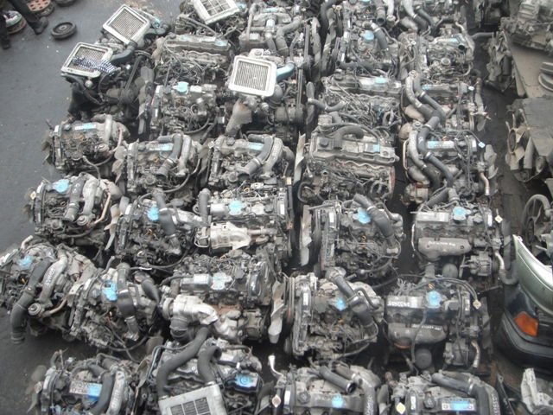
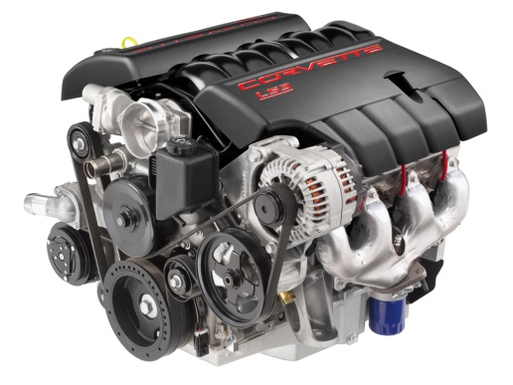
Moving forward
Encourage value adding activity such as remanufacture
To encourage value-adding activities to generate higher income for the nation.
Increase the used of recycled parts to preserve green environment.

Slide 14
Moving forward
Develop online virtual marketplace for recycled parts
Cost efficient ways to market recycled parts.
Time savings method for consumers to search for desired parts.
Gradual standardizing the pricing via market force.
Gradual increase the transparency of pricing throughout the nation.

Slide 15
Moving forward
Tap on the advantage of motor insurance policy
Discuss with insurance company to use quality recycled parts for the repair of accident cars.

Slide 16
Conclusion
As Malaysian have various competitive advantage within the country, so the industry players shall take initiative to upgrade themselves with quality recycled parts before they can penetrate the more international market.
Beside aiming to be the regional automotive hub in ASEAN, the government shall include recycled parts in the roadmap so that Malaysia can become the recycled parts hub for the region too.
Globalization has make the world flat, therefore setting up international standardization on recycled parts should be the priority task for all the players to ease the procurement when importing and exporting.

Slide 17
Thank you !
Thank you!
谢谢!
Баярлалаа!
감사합니다!
ありがとう!
Thank you!
谢谢!
Баярлалаа!
감사합니다!
ありがとう!

